Slide 1
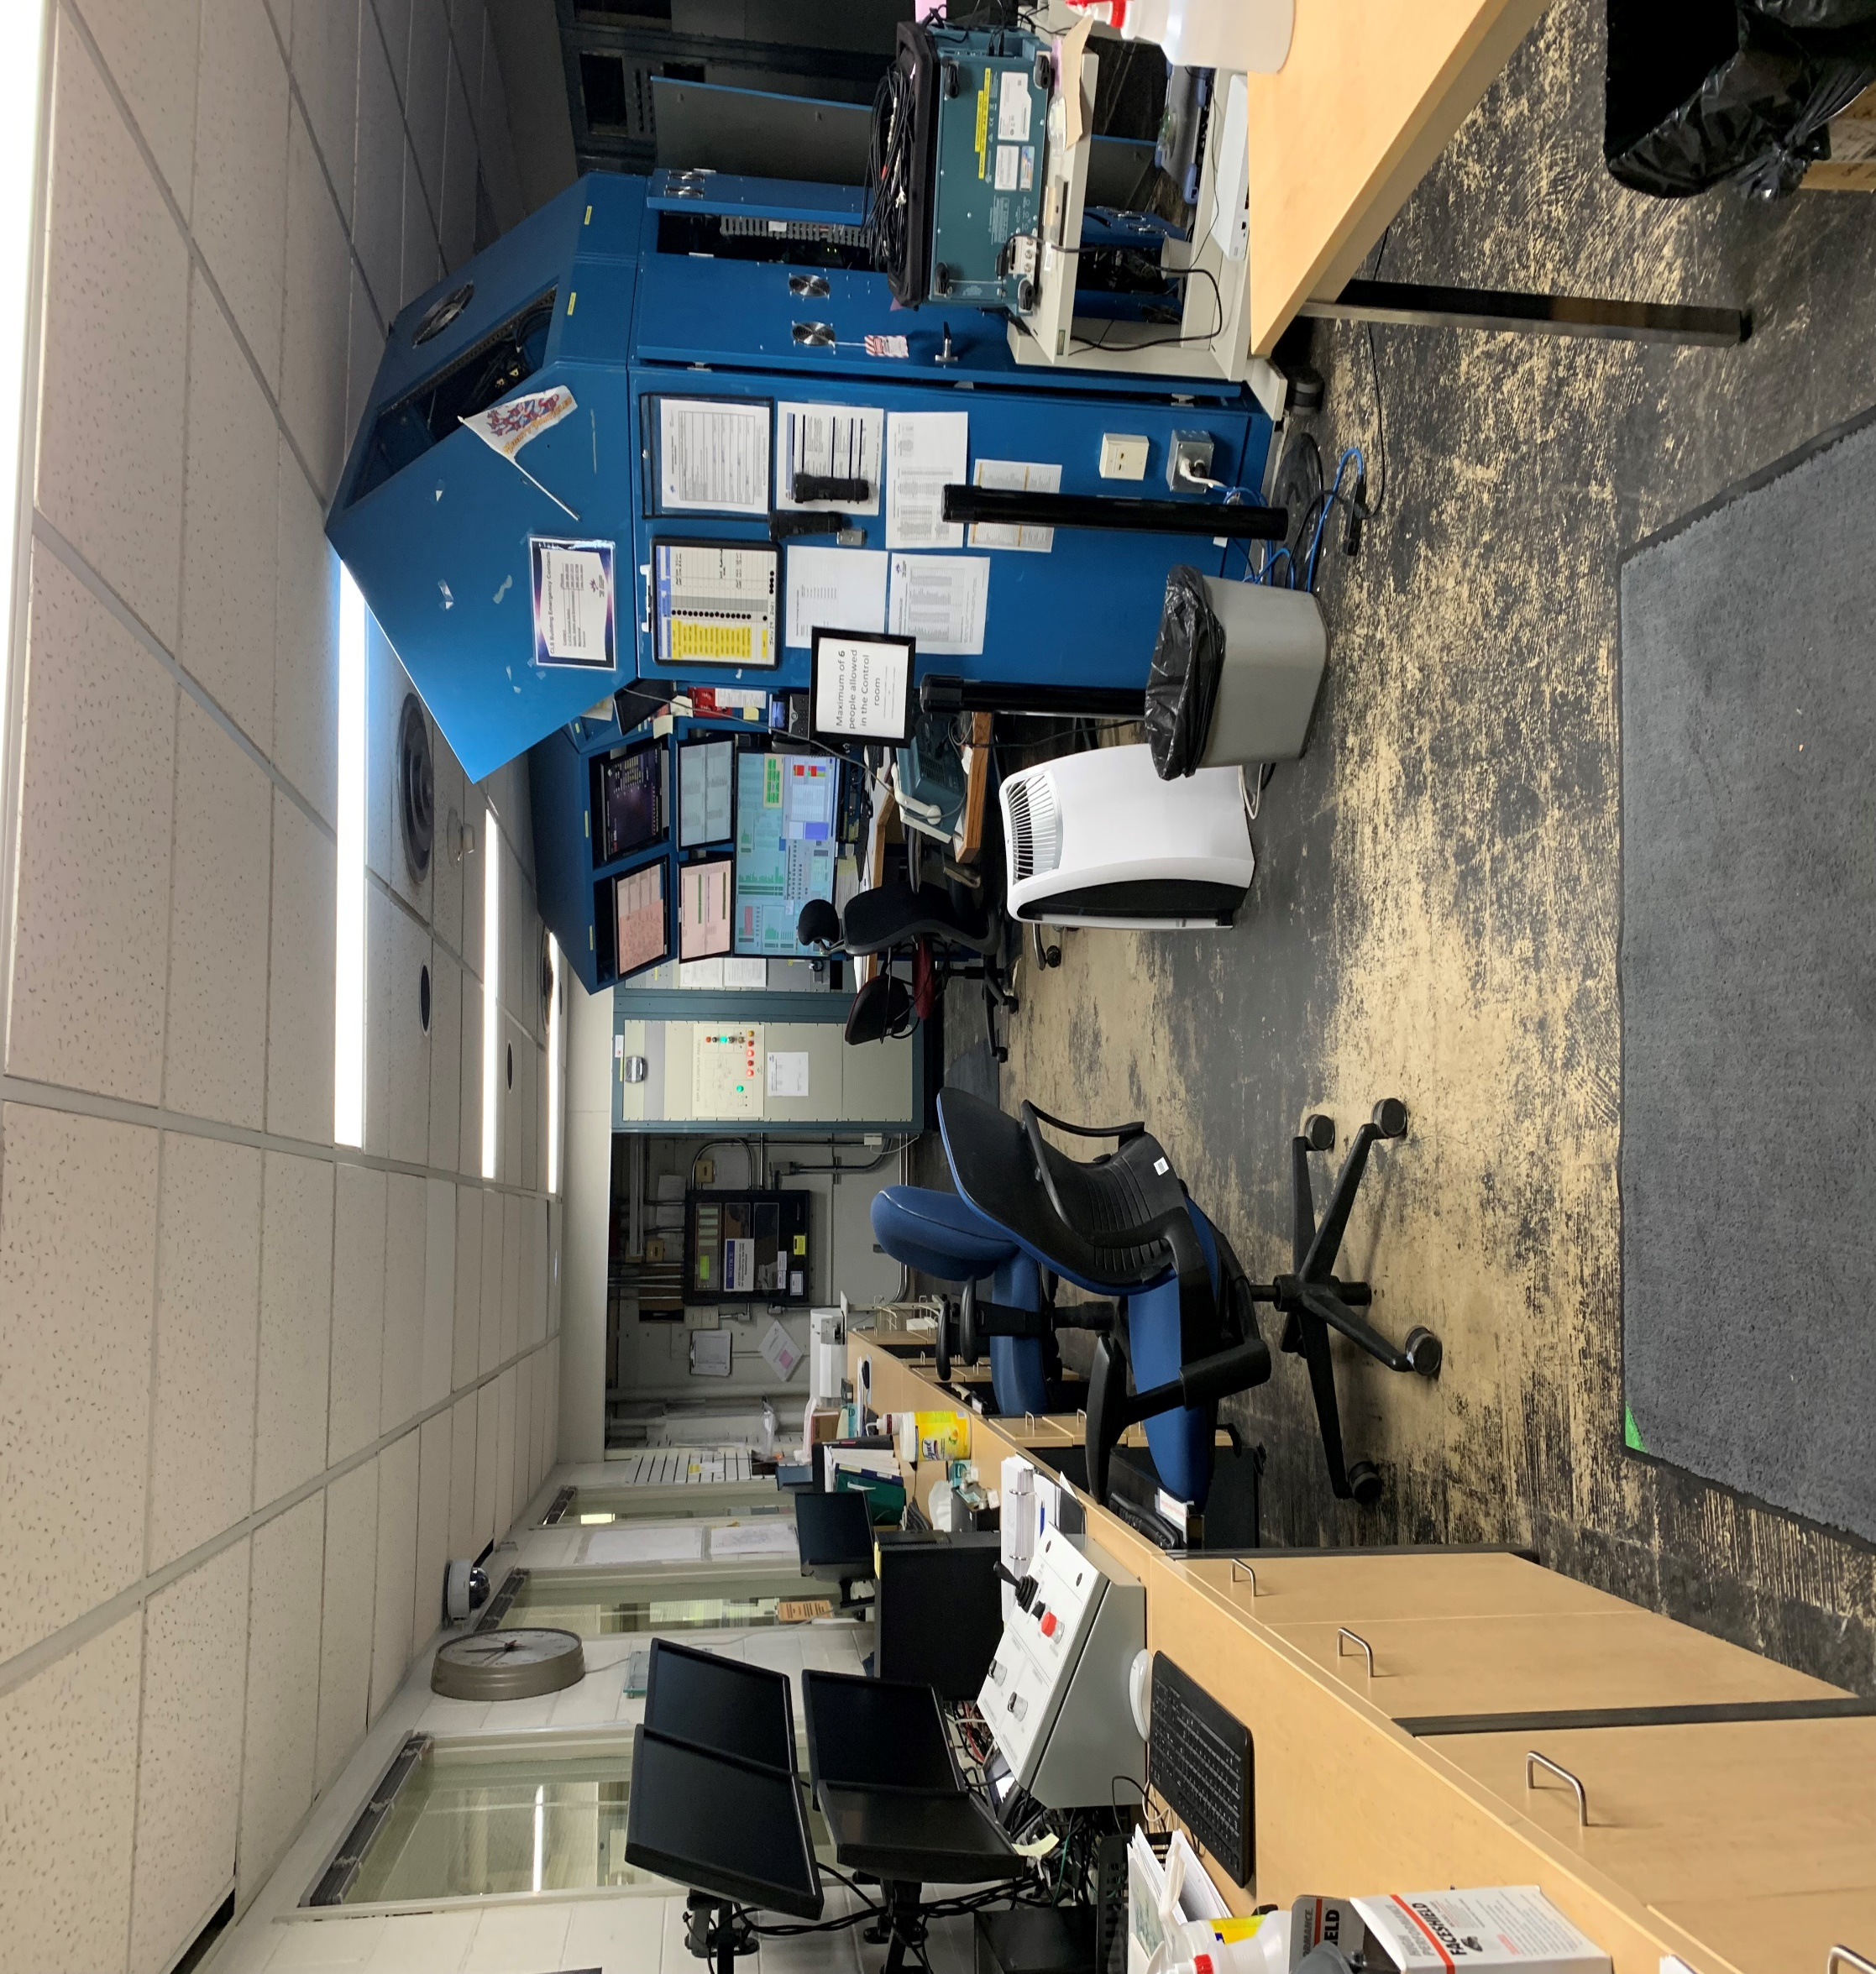
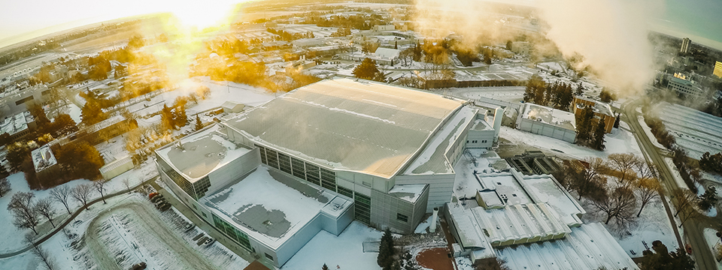
From New to Experienced: How the Pandemic Prepared the Operator Group at the Canadian Light Source
The Operators of the Canadian Light Source (Saskatoon, SK)
By: Ethan Herman and Chelsea-Lea Randall
Abstract
COVID-19 Pandemic
Important Events/Dates
Conclusions
The pandemic has shifted the workforce around the world. With a relatively new operator group at the CLS, our group will present how we dealt with the pandemic right from the start. We will explain our situation involving the facility, working with staff and other important situations that have fallen on us during this time and how we adapted to rapid change that better prepared us for the future of the CLS Operator group. Some important situations included planned and unplanned power outages and the prolonged damaged it had caused on equipment in the facility, an outbreak of COVID-19 with facility staff as well as our mental wellbeing during a period of absolute uncertainty.
Pandemic arrived in the province of Saskatchewan in the beginning of March, 2020
A state of emergency province-wide was put into place 2 weeks later
Lots of uncertainty for staff at CLS, especially us as a newer group of employees (potential layoffs, job cuts, etc.)
In addition to State of Emergency, a stay at home order was put in place by province except if it is essential for someone to be in facility
This affected our group in that we were deemed essential to operations
Facility was put in “Warm standby” – meaning we were ready to run should we are given the go ahead
Our team adjusted from a 2 persons/team to essentially one person being on shift either day or night cohorting amongst our group
Work a shift once every 5 days approximately
Very eerie at first as our team and the commissionaire were only ones in the building
No one could come in to help fix machine or components unless it was absolutely necessary as a result
Had to step outside our comfort zone to adapt to situations that occurred during shifts (i.e. water leaks, fire alarms, etc.)
Gave us a great opportunity to explore internals of machine
Gave us opportunities to enhance learning of our role as operators
Also enhanced our skills in being operators
Important Milestones were achieved during the pandemic with the goal of assisting in COVID-19 research with other facilities around the globe
June 2020 – Facility was put into development mode; results in having 2 operators on shift with heavy health restrictions
This lasted for the rest of the summer with some Maintenance shifts and Development Shifts thrown in (mixture of both)
August, 2020 – A setback
A rupture disk broke on the Storage Ring RF due to an unexpected power outage
This prevented us from continuing on with operations
Good news is that the repair was quick and operations resumed with a mixture of development and maintenance shifts
Returned to Normal Operations after repair and months of Development and Maintenance Shifts
September 2020 – March, 2021
Normal operation activities resumed with a small number of staff present in the building
Activities included condition of LINAC, both fall and spring outages and Normal Operations for COVID-19 research
April 2021 – Another Setback (or two)
A COVID-19 outbreak occurred at the CLS (determined by provincial health authority)
This resulted in 11 confirmed cases
Also resulted in use reverting back to warm standby mode
In addition, Another power outage (unexpected) created a problem with our liquid helium line for the Storage Ring RF
Fortunately, repair again was swift, however the confirmed cases of COVID-19 were a concern since they affected colleagues our team interacts with
After roughly a month, the outbreak was declared over and operations resumed from the provincial health authority
Our group rose to the challenge very well
Overall, facility staff were impressed with our resilience and ability to adapt to the unexpected
Certain events tested our abilities and skills (unplanned power outages) and created areas to improve procedure and focused attention of what our team needed to focus on
Our group overcame obstacles to achieve an end goal of participating in the return to normal operation
Our team is relatively new to the synchrotron operations family of operators, but we have demonstrated we are ready for any challenge that is thrown at our team
Background
Control Room
CLS created an operator team in 2019
Goal of team was to operate machine 24/7 and address any issues from users during normal operation
Operator Team consists of 10 Full time Operators working 12 hour shifts (day and night)
Two team of 2 operators on during a given shift
Also assist in troubleshooting problems with various tradespeople and support staff that are essential in the operation of the machine
Relatively new group both in terms of operations and with the CLS
Contacts at the CLS
Ethan Herman – Operator- Canadian Light Source
ethan.herman@lightsource.ca
Grant Bilbrough – Operations Lead
grant.bilbrough@lighsource.ca
Frederic Le Pimpec – Accelerator Operations Manager Frederic.Le.Pimpec@LIGHTSOURCE.CA
Mark Boland – Machine Director - mark.boland@lightsource.ca

